Slide 1
Deep learning for topology optimization of 2D metamaterials
Hunter T. Kollmann, Diab W. Abueidda, Seid Koric, Erman Guleryuz, Nahil A. Sobh
Presented by Tianyu Liang
SCUT Machine Intelligence Laboratory
Nov 25, 2021

Slide 2
Contents
1
Background
2
Motivation
3
Proposed Method
4
Experimental Results
5
Conclusion

Slide 3
Contents
1
Background
2
Motivation
3
Proposed Method
4
Experimental Results
5
Conclusion

Slide 4
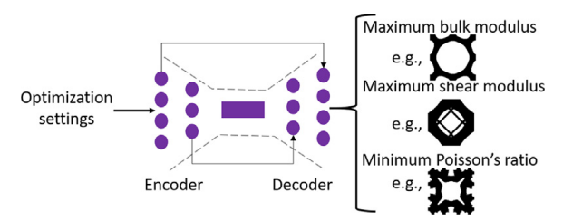
Mechanical metamaterials
Mechanical metamaterials are materials with unique architectures leading to mechanical properties unattainable by their constituent materials.
What does this paper aim to do?
Predicts optimal designs in terms of following properties:
Maximizing the bulk modulus, maximizing the shear modulus, minimizing the Poisson's ratio.

Slide 5
How to optimize
These materials are usually optimized through the choice of :
(i) Constituent materials (×) relatively mature
(ii) Volume fraction (×) relatively mature
(iii) Architecture (√ )

Slide 6
Previous method
Topology optimization
-- high-dimensional design space
Bidirectional evolutionary structural optimization (BESO)
-- maximize bulk or shear modulus (Poisson's ratio)
Numerical analyses
-- require a lot of iterations, computationally expensive

Slide 7
Contents
1
Background
2
Motivation
3
Proposed Method
4
Experimental Results
5
Conclusion

Slide 8
Motivation
Motivation of the proposed method
ML has been an effective computational tool in many fields.
Data-driven models have shown efficiency in accelerating design processes and materials discovery.
Many papers apply DL algorithms to accelerate the topology optimization process of structural systems.

Slide 9
Contents
1
Background
2
Motivation
3
Proposed Method
4
Experimental Results
5
Conclusion

Slide 10
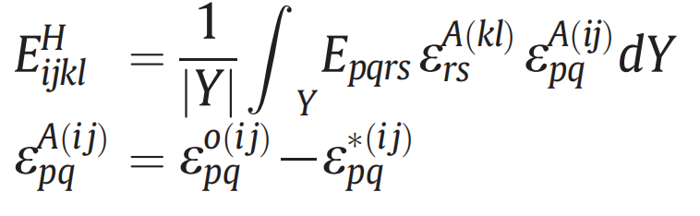
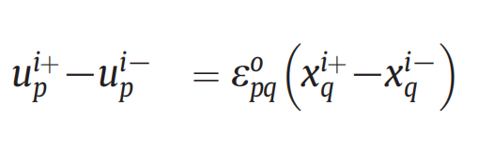
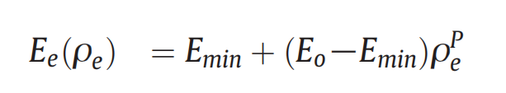
Mathematical model
To evaluate effective properties, one needs to use the homogenization theory and periodic boundary conditions (PBCs).
Homogenized stiffness tensor:
Satisfy the following boundary condition:
Solid isotropic material penalization (SIMP) for optimization

Slide 11
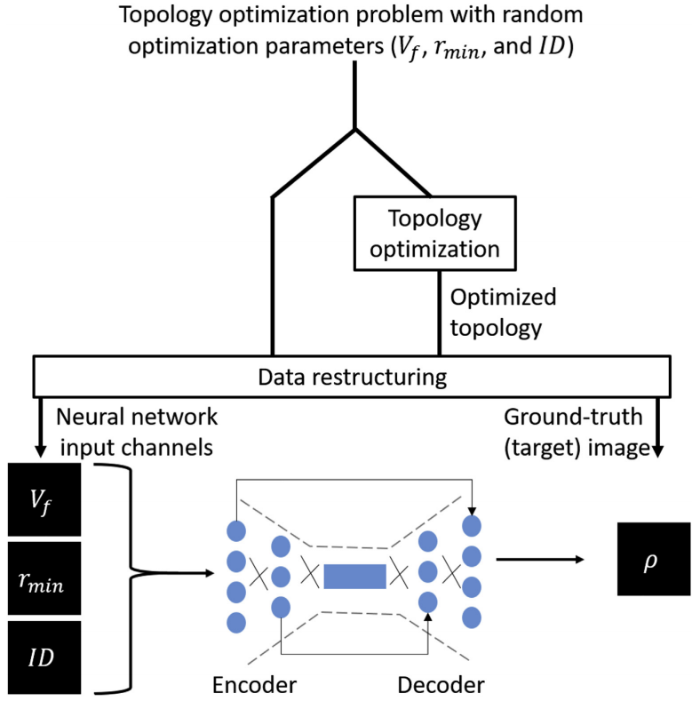
Overview
Three input images (one for each optimization parameter)
One output image.
Filter radius, volume fraction, a design objective (maximum bulk modulus, maximum shear modulus, or minimum Poisson's ratio)

Slide 12
Overview
For the volume fraction and the filter radius images, all pixels are assigned a value sampled from the corresponding ranges.
For the design objective image, all pixels are assigned a numeric identifier ID ∈ {0,1,2}

Slide 13
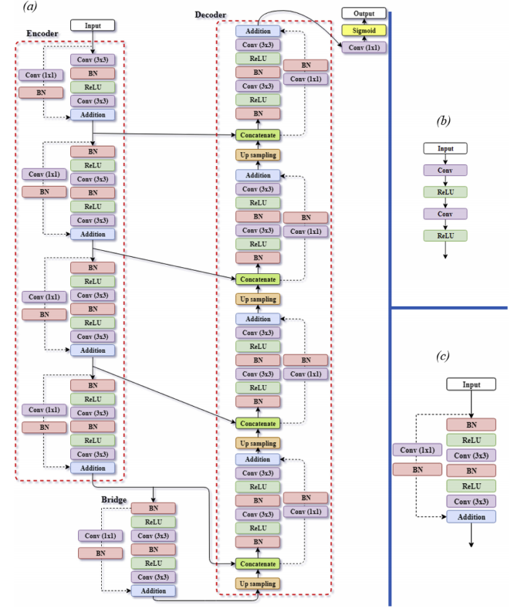
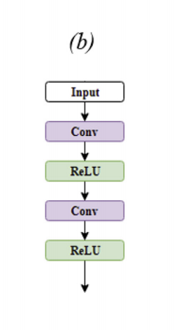
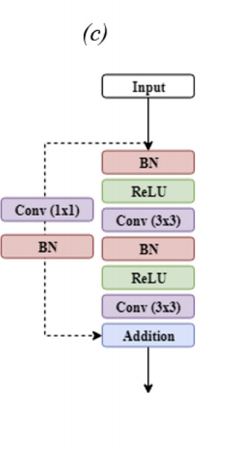
DL model
ResUNet (ResNet + U-Net)
Takes advantage of residual learning and U-Net

Slide 14
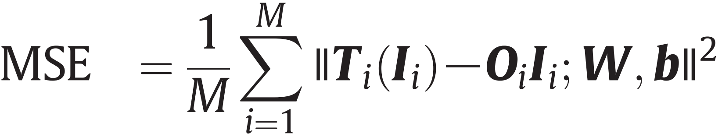
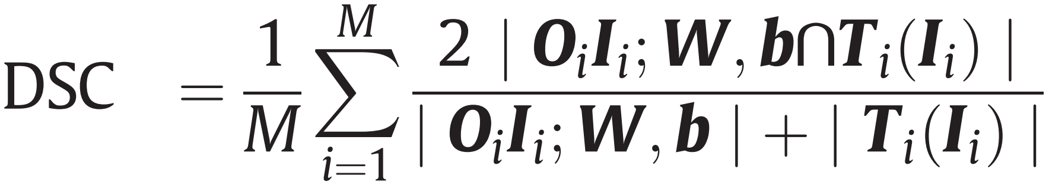
Loss and evaluation
Loss function was defined as the Mean Squared Error
T(I) :ground-truth segmentation
O (I;W,b) :segmentation generated by the CNN model
Evaluate the performance of the CNN model by monitoring the mean DSC
Similarity

Slide 15
Contents
1
Background
2
Motivation
3
Proposed Method
4
Experimental Results
5
Conclusion

Slide 16
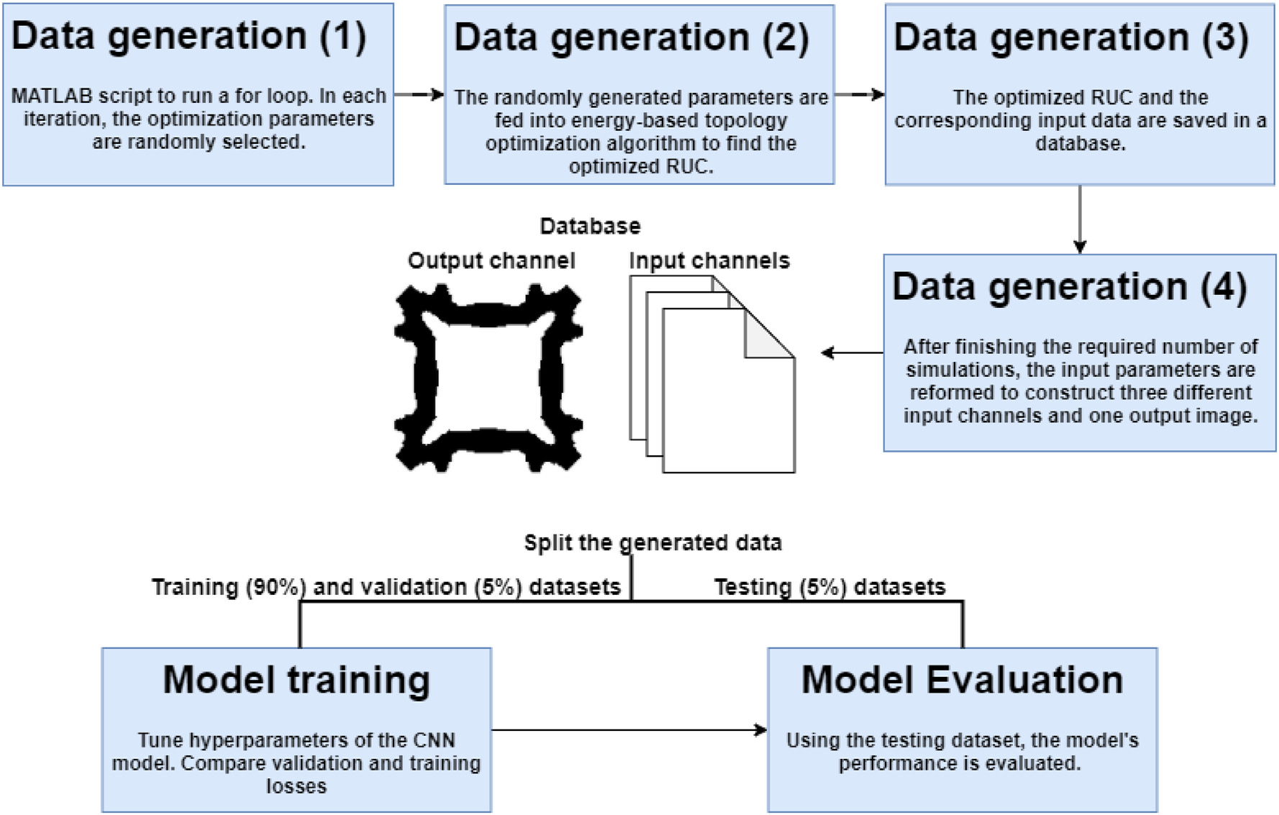
Experimental Results
Dataset generation
Topology optimization problem with randomly sampled optimization parameters.
Training(90%), validation(5%), Testing(5%)

Slide 17
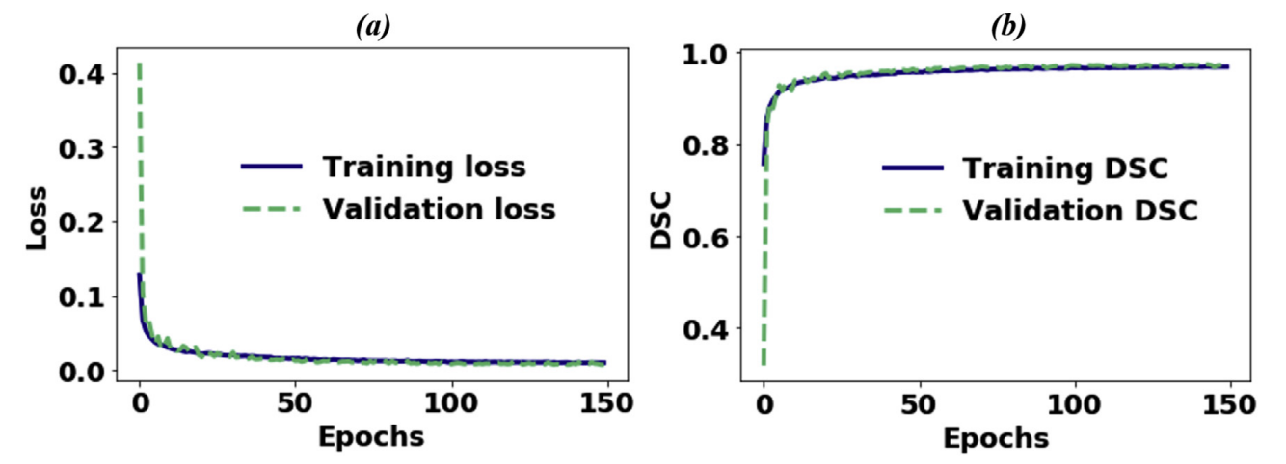
Experimental Results
Convergence
The model is trained using 150 epochs. ( 9.1 hours )
The difference between the validation and training losses is small
The training and validation DSCs are also quite high (close to 1.0)

Slide 18
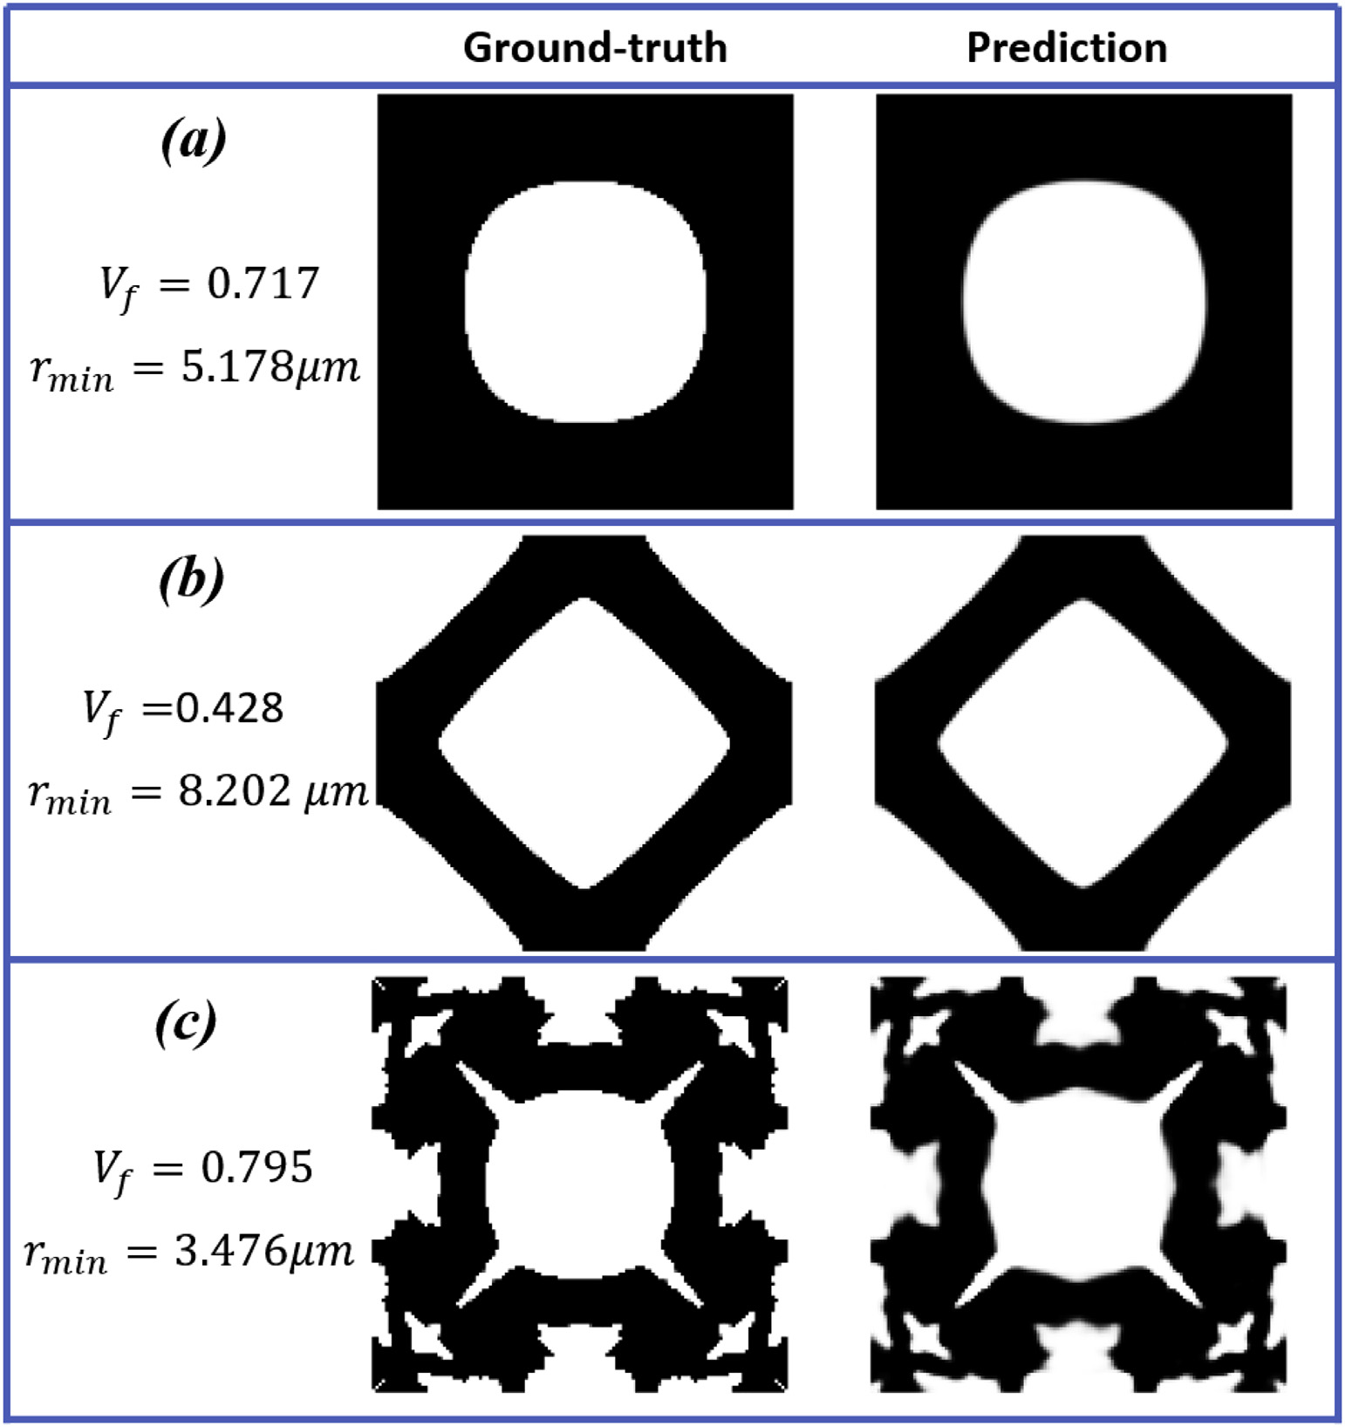
Experimental Results
Proposed method compared with simulation
Deviations of the prediction objective function and volume from those of the ground-truth are:
2.16% and 0.16%
0.74% and 1.49%
3.29% and 1.06%

Slide 19
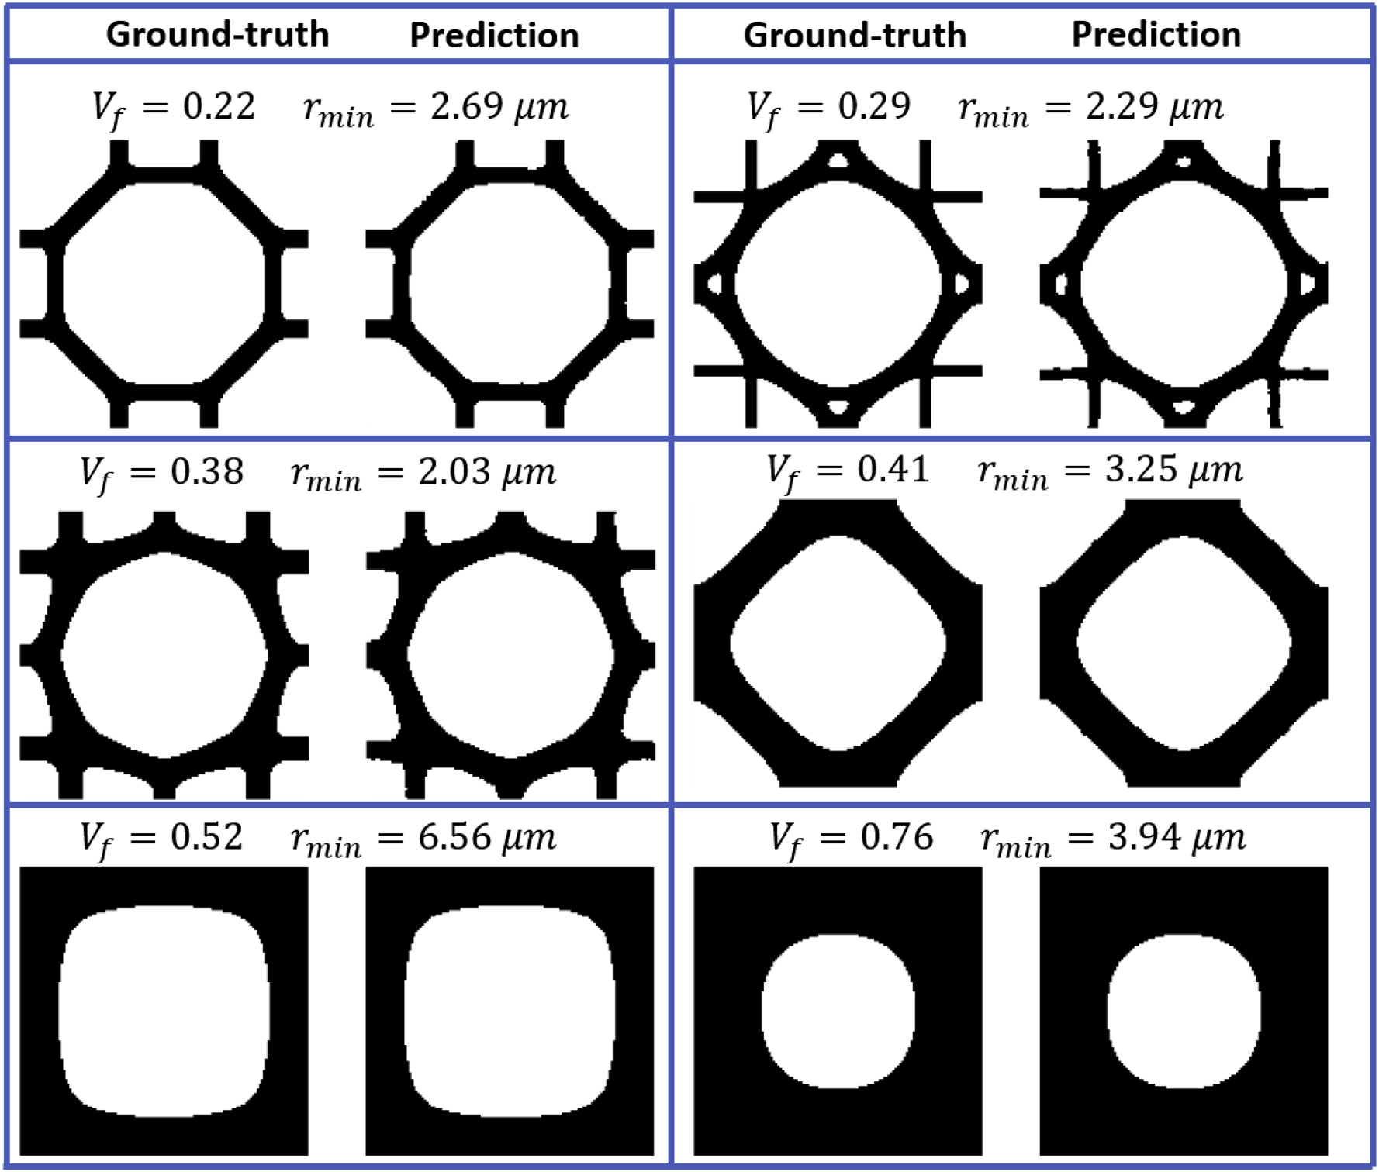
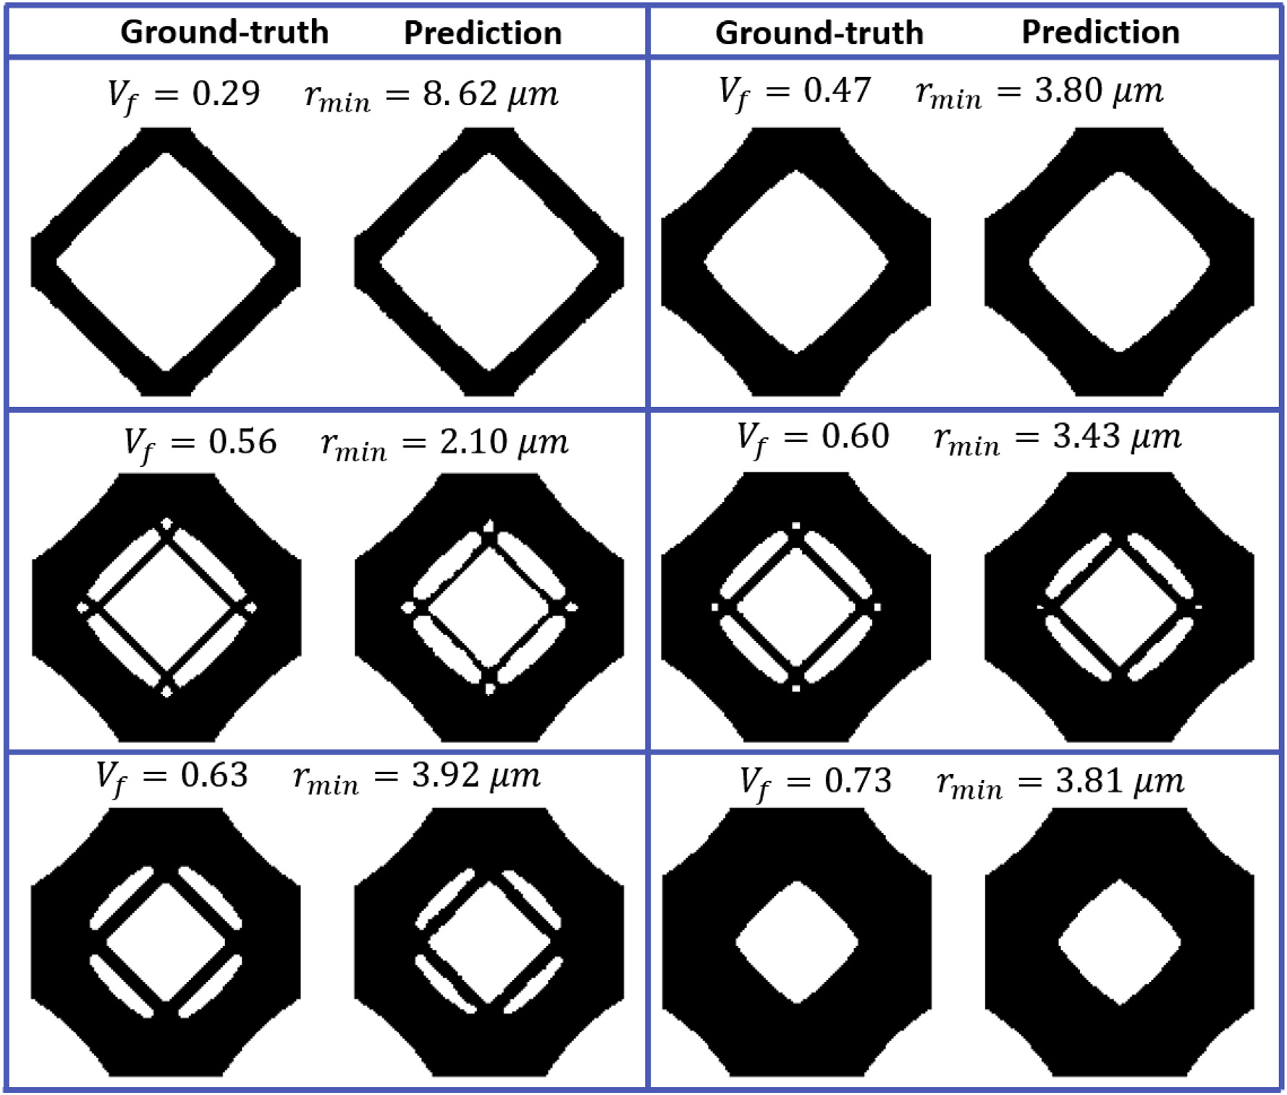
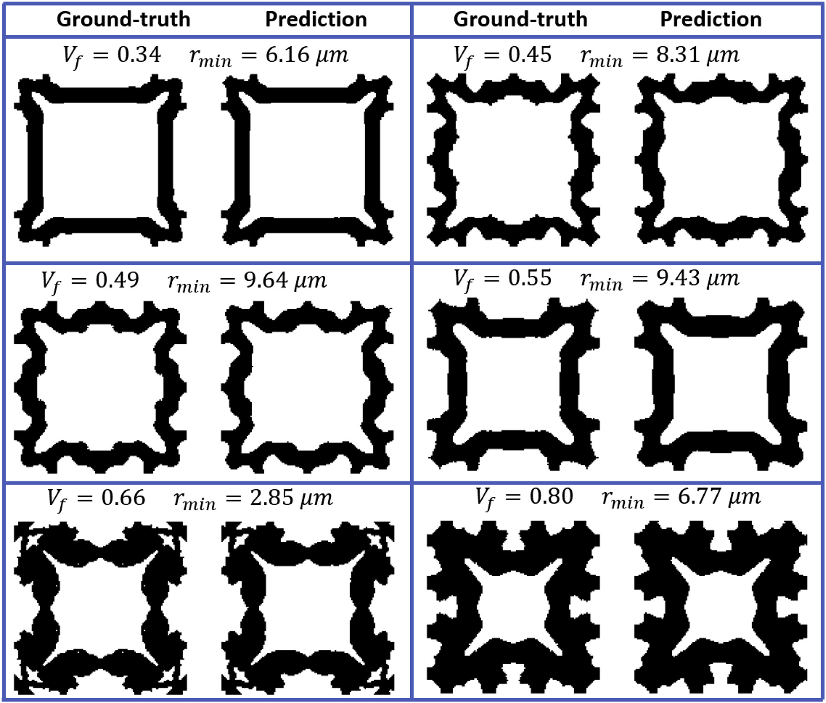
Experimental Results
Proposed method compared with simulation
Densities range from 0 to 1.
Using a 0.5 threshold to mapping densities to 0 and 1.
The predicted distributions are near identical to the ground-truth.

Slide 20
Contents
1
Background
2
Motivation
3
Proposed Method
4
Experimental Results
5
Conclusion

Slide 21
Conclusion
Contributions
Develop a CNN model in order to predict the optimized metamaterial design for maximizing the bulk modulus, maximizing the shear modulus, or minimizing the Poisson's ratio.
A topology optimization framework, involving the energy-based homogenization method and periodic boundary conditions.

Slide 22
Thank You
Thank You
Q&A

